Slide 1

Introductory talk

Slide 2
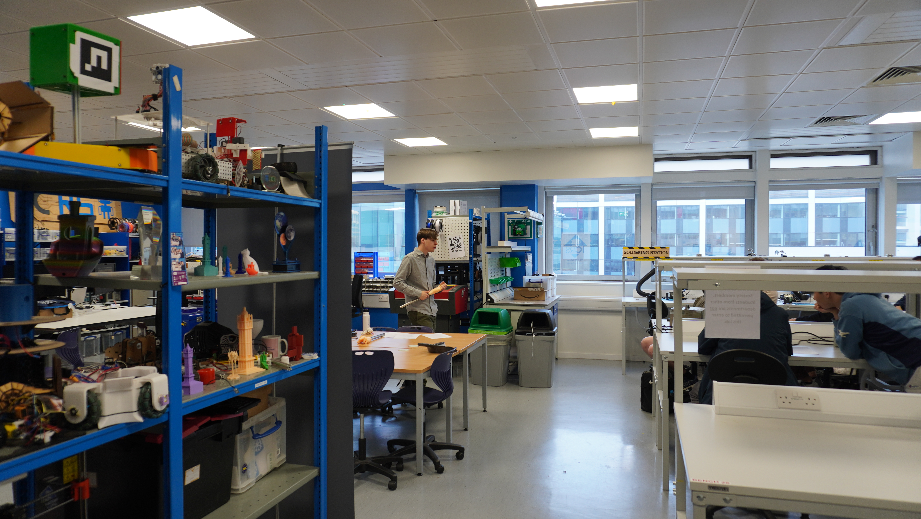
Agenda
1. Who are ICRS? What do we do?
2. What makes a robot?
3. What is the aim of robotics 101?
4. The plan for the rest of this session

Slide 3
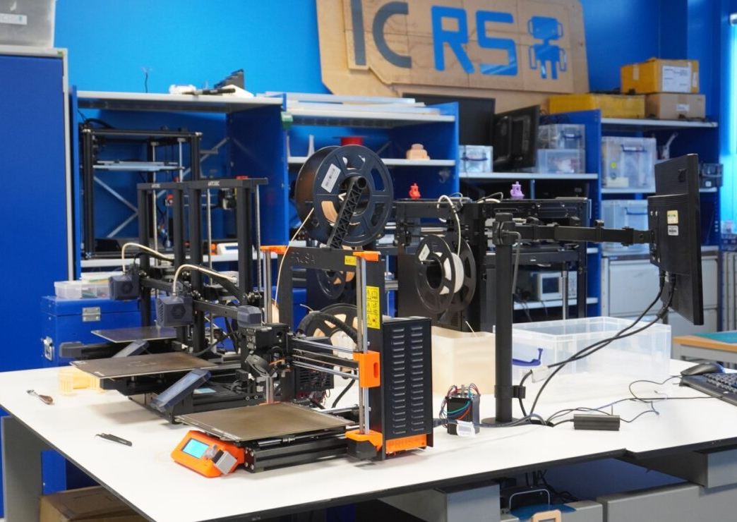
What is ICRS?
Makerspace
6 3D printers
1 laser cutter
All the tools you could want
Projects/events
IPRL rover
Robocup
Robotics 101
Terrible ideas hackathon

Slide 4
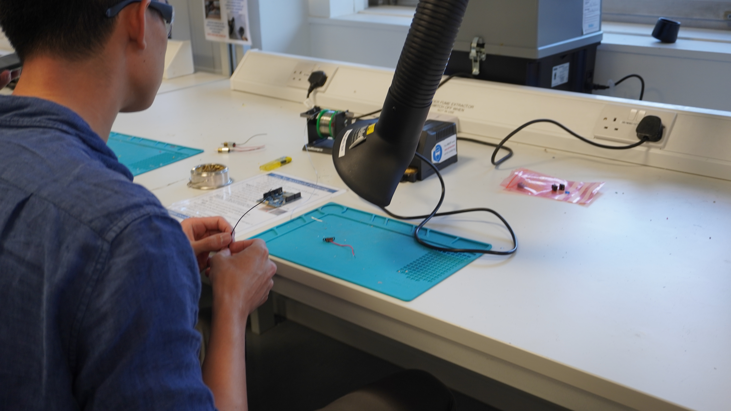
What is a robot?
A robot has three elements:
The ability to gather data
The ability to process, or do something with the gathered data
The ability to interact with the environment
“I can’t define a robot but I know one when I see one.”
- Joseph Engelberger

Slide 5
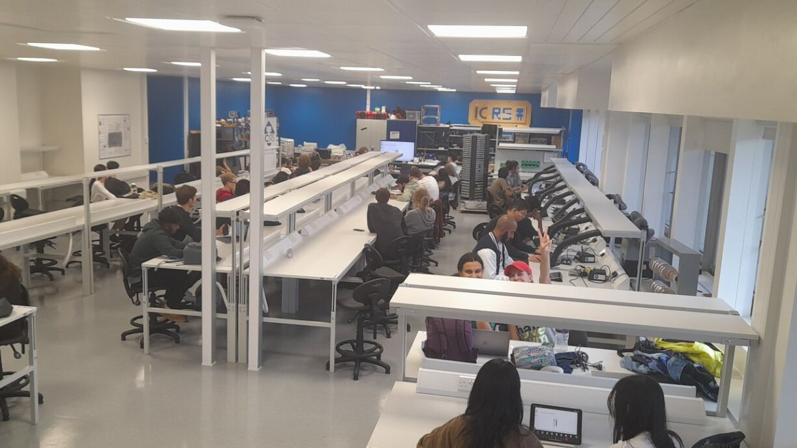
What is Robotics 101?
Introductory course covering the basics for building a simple robot
Session 1: Computer aided design
Session 2: Electronics and circuit design
Session 3: Programming with microcontrollers
A robot has three elements:
The ability to gather data
The ability to process, or do something with the gathered data
The ability to interact with the environment

Slide 6
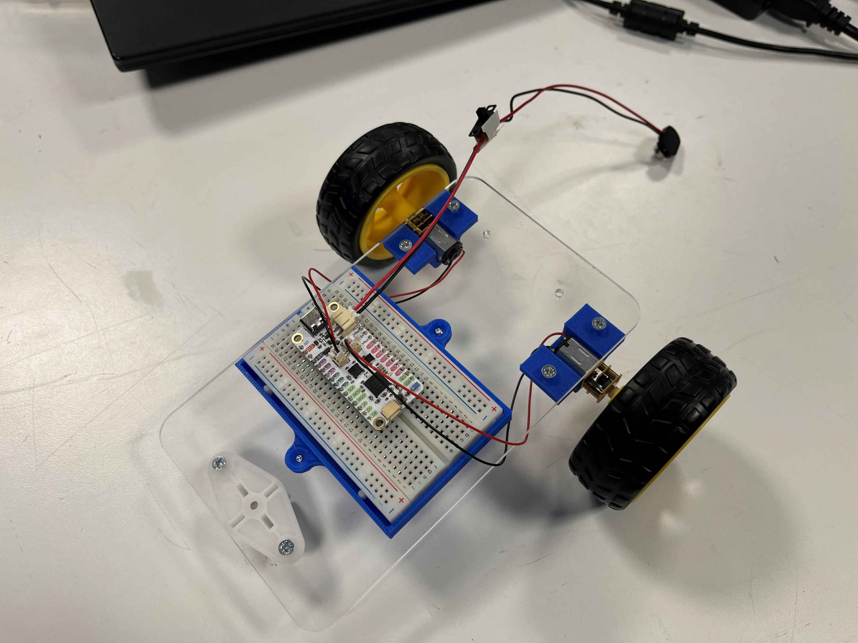
Goals
Build robot
Remote control
Move around
Ability to battle
Gain basic skills to be able to join society projects and make your own projects come to life.

Slide 7
Session Plan
Session 1: Computer aided design
Session 2: Electronics, circuit design & robot assembly
Session 3: Software
Session 4: Testing, debugging and competition.

Slide 8
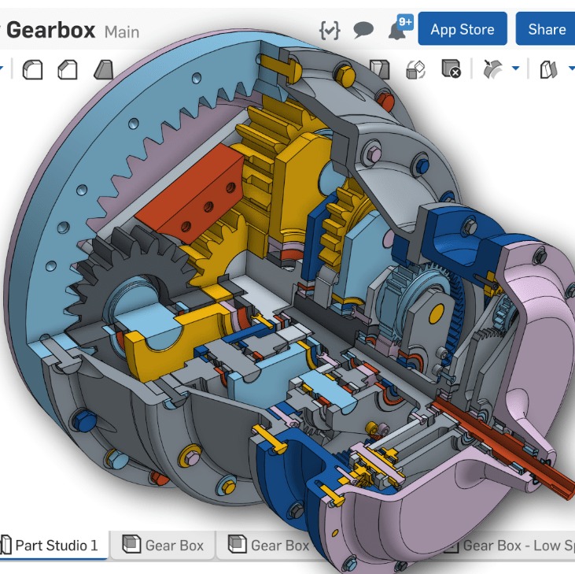
CAD – Computer Aided Design
Best way to get engineering ideas on to a page!
Allows you to see if parts will fit together or moving parts will obstruct one another.
Foundational skill of mechanical design
Notes:
CAD stands for computer aided design and is the best way to get engineering ideas out of your brain and onto a page/screen
Allows you to see if parts will fit together or moving parts will obstruct one another.
It is the foundational skill of mechanical design allowing you to go more indepth with your design like determining how it will be manufactured and assembled
If you are 3d printing the piece try and make it have as few overhangs as possible so that it doesn’t require support material
You can even do finite element analysis on pieces to determine if they are thick enough and strong enough to withstand typical loads

Slide 9
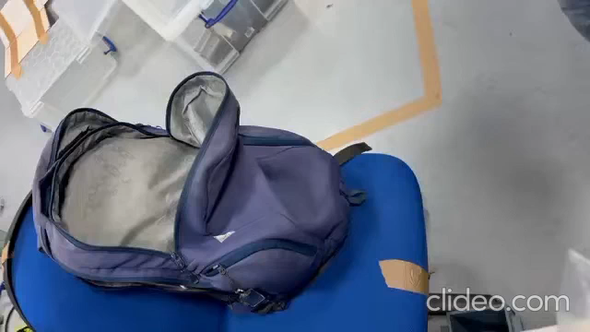

Slide 10
https://github.com/ICRS/101

